Slide 1
Permutations and
Combinations
Dr. Rakhee Chhibber

Slide 2
Objectives:
apply fundamental counting principle
compute permutations
compute combinations
distinguish permutations vs combinations

Slide 3
Fundamental Counting Principle
Fundamental Counting Principle can be used determine the number of possible outcomes when there are two or more characteristics .
Fundamental Counting Principle states that if an event has m possible outcomes and another independent event has n possible outcomes, then there are m* n possible outcomes for the two events together.

Slide 4
Fundamental Counting Principle
Lets start with a simple example.
A student is to roll a die and flip a coin. How many possible outcomes will there be?
1H 2H 3H 4H 5H 6H
1T 2T 3T 4T 5T 6T
12 outcomes
6*2 = 12 outcomes

Slide 5
Fundamental Counting Principle
For a college interview, Robert has to choose what to wear from the following: 4 slacks, 3 shirts, 2 shoes and 5 ties. How many possible outfits does he have to choose from?
4*3*2*5 = 120 outfits

Slide 6
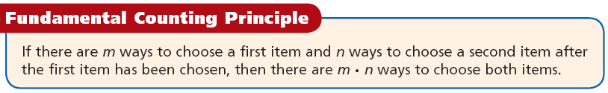
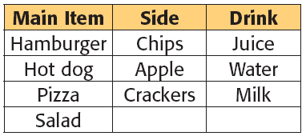
Recap
A lunch special includes one main item, one side, and one drink.
How many different meals can you choose if you pick one main item, one side, and one drink?
4 x 3 x 3 =36

Slide 7
Benefits of the Fundamental Counting Principle
A sandwich can be made with 3 different types of bread, 5 different meats, and 2 types of cheese. How many types of sandwiches can be made if each sandwich consists of one bread, one meat, and one cheese.
Bread
1
2
3
Meat
1 2 3 4 5
1 2 3 4 5
1 2 3 4 5
Cheese
1 2 1 2 1 2 1 2 1 2
1 2 1 2 1 2 1 2 1 2
1 2 1 2 1 2 1 2 1 2
There are 30 possible types of sandwiches (cumbersome)

Slide 8
Permutations
A Permutation is an arrangement of items in a particular order.
Notice, ORDER MATTERS!
To find the number of Permutations of n items, we can use the Fundamental Counting Principle or factorial notation.

Slide 9
Permutations vs. Combinations
Both are ways to count the possibilities
The difference between them is whether order matters or not
Consider a poker hand:
  A♦, 5♥, 7♣, 10♠, K♠
Is that the same hand as:
  K♠, 10♠, 7♣, 5♥, A♦
Does the order the cards are handed out matter?
  If yes, then we are dealing with permutations
  If no, then we are dealing with combinations

Slide 10
Permutations
A permutation is an ordered arrangement of the elements of some set S
  Let S = {a, b, c}
  c, b, a is a permutation of S
  b, c, a is a different permutation of S
An r-permutation is an ordered arrangement of r elements of the set
  A♦, 5♥, 7♣, 10♠, K♠ is a 5-permutation of the set of cards
The notation for the number of r-permutations: P(n,r)
  The poker hand is one of P(52,5) permutations

Slide 11
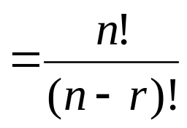
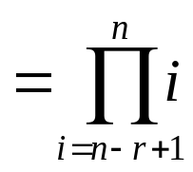
Permutations
Number of poker hands (5 cards):
  P(52,5) = 52*51*50*49*48 = 311,875,200
Number of (initial) blackjack hands (2 cards):
  P(52,2) = 52*51 = 2,652
r-permutation notation: P(n,r)
  The poker hand is one of P(52,5) permutations

Slide 12
r-permutations example
How many ways are there for 5 people in this class to give presentations?
There are 27 students in the class
  P(27,5) = 27*26*25*24*23 = 9,687,600
  Note that the order they go in does matter in this example!

Slide 13
Permutation formula proof
There are n ways to choose the first element
  n-1 ways to choose the second
  n-2 ways to choose the third
  …
  n-r+1 ways to choose the r^{th} element
By the product rule, that gives us:
P(n,r) = n(n-1)(n-2)…(n-r+1)

Slide 14
Permutations vs. r-permutations
r-permutations: Choosing an ordered 5 card hand is P(52,5)
  When people say “permutations”, they almost always mean r-permutations
    But the name can refer to both
Permutations: Choosing an order for all 52 cards is P(52,52) = 52!
  Thus, P(n,n) = n!

Slide 15
Permutations
The number of ways to arrange the letters ABC:
____ ____ ____
Number of choices for first blank?
3 ____ ____
Number of choices for second blank?
3 2 ___
Number of choices for third blank?
3 2 1
3*2*1 = 6 3! = 3*2*1 = 6
ABC ACB BAC BCA CAB CBA

Slide 16
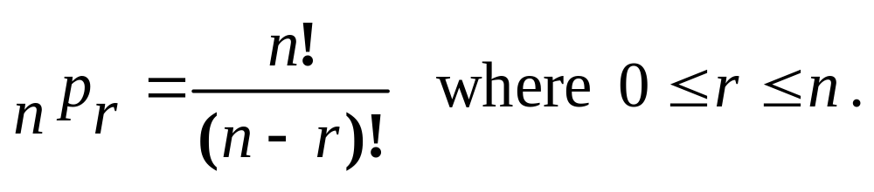
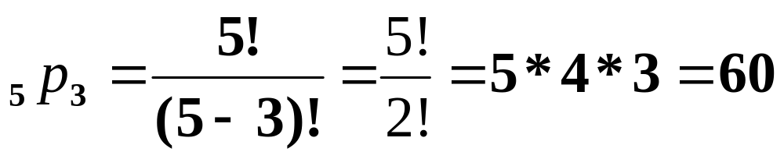
Permutations
To find the number of Permutations of n items chosen r at a time, you can use the formula

Slide 17

Permutations
Practice:
A combination lock will open when the right choice of three numbers (from 1 to 30, inclusive) is selected. How many different lock combinations are possible assuming no number is repeated?
Answer Now

Slide 18
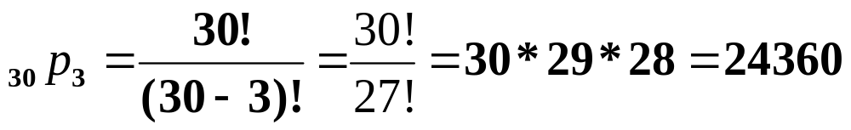
Permutations
Practice:
A combination lock will open when the right choice of three numbers (from 1 to 30, inclusive) is selected. How many different lock combinations are possible assuming no number is repeated?

Slide 19
Permutations
Practice:
From a club of 24 members, a President, Vice President, Secretary, Treasurer and Historian are to be elected. In how many ways can the offices be filled?
Answer Now

Slide 20
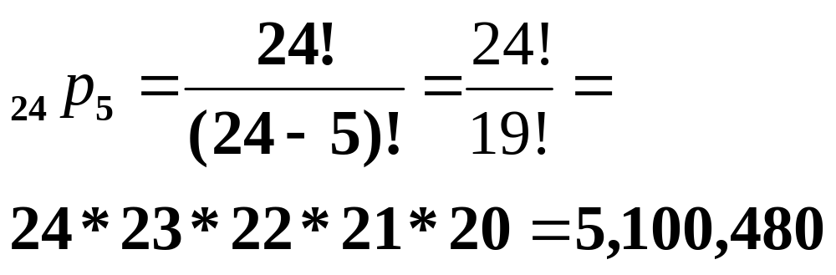
Permutations
Practice:
From a club of 24 members, a President, Vice President, Secretary, Treasurer and Historian are to be elected. In how many ways can the offices be filled?

Slide 21
Question 1
An English test contains five different essay questions labeled A, B, C, D, and E. You are supposed to choose 2 to answer. How many different ways are there to do this?

Slide 22
Question 2
A voicemail system password is 1 letter followed by a 3-digit number less than 600. How many different voicemail passwords are possible?

Slide 23
Question 3
A family of 3 plans to sit in the same row at a movie theater. How many ways can the family be seated in 3 seats?

Slide 24
Question 4
Ingrid is stringing 3 different types of beads on a bracelet. How many ways can she string the next three beads if they must include one bead of each type?

Slide 25
Question 5
Nathan wants to order a sandwich with two of the following ingredients: mushroom, eggplant, tomato, and avocado. How many different sandwiches can Nathan choose?

Slide 26
Question 6
A group of 8 swimmers are swimming in a race. Prizes are given for first, second, and third place. How many different outcomes can there be?

Slide 27
Question 7
How many different ways can 9 people line up for a picture?

Slide 28
Question 8
Four people need to be selected from a class
of 15 to help clean up the campus. How many different ways can the 4 people be chosen?

Slide 29
See how you are getting on….
…. swap sheets with person behind you.

Slide 30
Question 1
An English test contains five different essay questions labeled A, B, C, D, and E. You are supposed to choose 2 to answer. How many different ways are there to do this?
The order of outcomes is not important, so this situation involves combinations.
⁵C₂ =10

Slide 31
Question 2
A voicemail system password is 1 letter followed by a 3-digit number less than 600. How many different voicemail passwords are possible if all digits are allowed?
The order of outcomes is important, so this situation involves permutations.
26 x 6 x 10 x 10 =15600

Slide 32
Question 3
A family of 3 plans to sit in the same row at a movie theater. How many ways can the family be seated in 3 seats?
The order of outcomes is important, so this situation involves permutations.
ABC
BAC
CAB
ACB
BCA
CBA
3 x 2 x 1 = 6

Slide 33
Question 4
Ingrid is stringing 3 different types of beads on a bracelet. How many ways can she string the next three beads if they must include one bead of each type?
The order of outcomes is important, so this situation involves permutations.
3x2x1=6

Slide 34
Question 5
Nathan wants to order a sandwich with two of the following ingredients: mushroom, eggplant, tomato, and avocado. How many different sandwiches can Nathan choose?
The order of outcomes is not important, so this situation involves combinations.
⁴C₂ =6

Slide 35
Question 6
A group of 8 swimmers are swimming in a race. Prizes are given for first, second, and third place. How many different outcomes can there be?
The order of outcomes is important, so this situation involves permutations.
8 x 7 x 6 = 336

Slide 36
Question 7
How many different ways can 9 people line up for a picture?
The order of outcomes is important, so this situation involves permutations.
9!= 362,880

Slide 37
Question 8
Four people need to be selected from a class
of 15 to help clean up the campus. How many different ways can the 4 people be chosen?
The order of outcomes is not important, so this situation involves combinations.
15 Choose 4 = 1365

Slide 38
Combinations
A Combination is an arrangement of items in which order does not matter.
ORDER DOES NOT MATTER!
Since the order does not matter in combinations, there are fewer combinations than permutations. The combinations are a "subset" of the permutations.

Slide 39
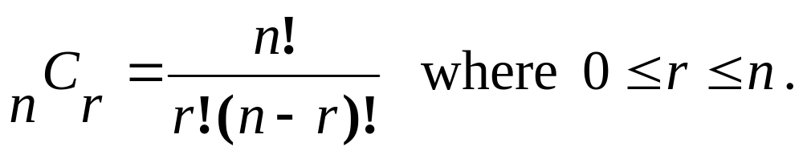
Combinations
To find the number of Combinations of n items chosen r at a time, you can use the formula

Slide 40
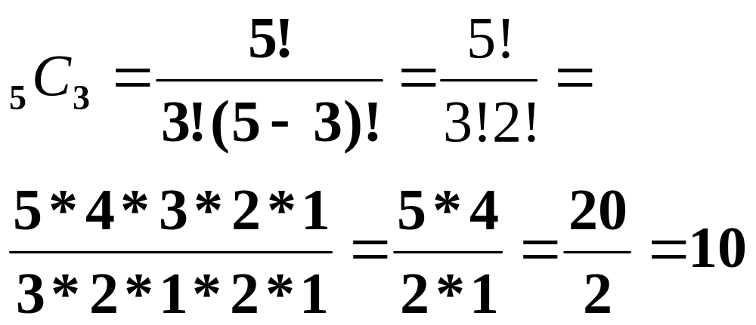
Combinations
To find the number of Combinations of n items chosen r at a time, you can use the formula

Slide 41
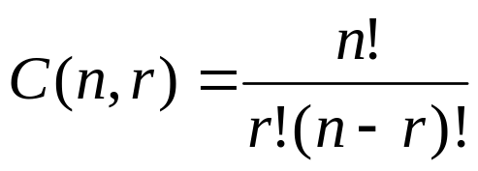
Combinations
What if order doesn’t matter?
In poker, the following two hands are equivalent:
  A♦, 5♥, 7♣, 10♠, K♠
  K♠, 10♠, 7♣, 5♥, A♦
The number of r-combinations of a set with n elements, where n is non-negative and 0≤r≤n is:

Slide 42
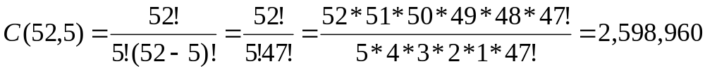
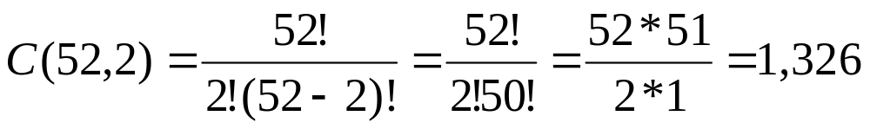
Combinations example
How many different poker hands are there (5 cards)?
How many different (initial) blackjack hands are there?

Slide 43
Combination formula proof
Let C(52,5) be the number of ways to generate unordered poker hands
The number of ordered poker hands is P(52,5) = 311,875,200
The number of ways to order a single poker hand is P(5,5) = 5! = 120
The total number of unordered poker hands is the total number of ordered hands divided by the number of ways to order each hand
Thus, C(52,5) = P(52,5)/P(5,5)

Slide 44
Combination formula proof
Let C(n,r) be the number of ways to generate unordered combinations
The number of ordered combinations (i.e. r-permutations) is P(n,r)
The number of ways to order a single one of those r-permutations P(r,r)
The total number of unordered combinations is the total number of ordered combinations (i.e. r-permutations) divided by the number of ways to order each combination
Thus, C(n,r) = P(n,r)/P(r,r)

Slide 45
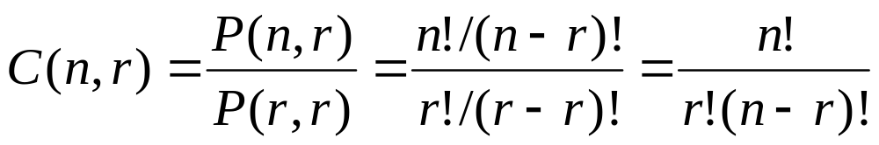
Combination formula proof

Slide 46
Combinations
Practice:
To play a particular card game, each player is dealt five cards from a standard deck of 52 cards. How many different hands are possible?
Answer Now

Slide 47
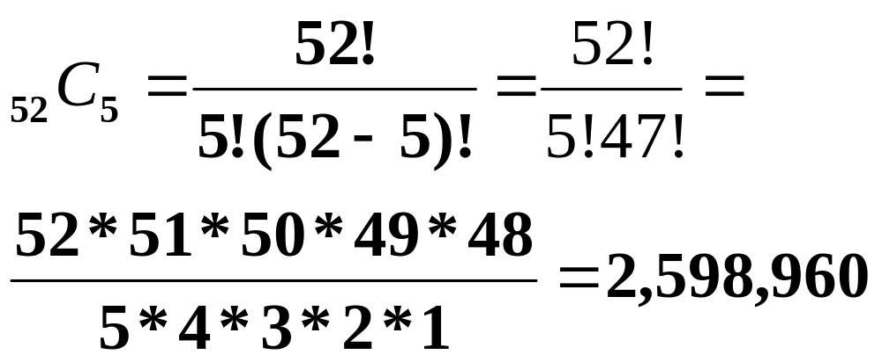
Combinations
To play a particular card game, each player is dealt five cards from a standard deck of 52 cards. How many different hands are possible?
Practice:

Slide 48
Combinations
Practice:
A student must answer 3 out of 5 essay questions on a test. In how many different ways can the student select the questions?
Answer Now

Slide 49
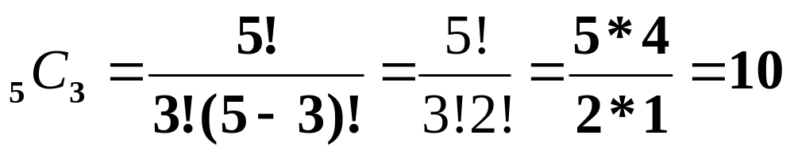
Combinations
A student must answer 3 out of 5 essay questions on a test. In how many different ways can the student select the questions?
Practice:

Slide 50
Combinations
Practice:
A basketball team consists of two centers, five forwards, and four guards. In how many ways can the coach select a starting line up of one center, two forwards, and two guards?
Answer Now

Slide 51
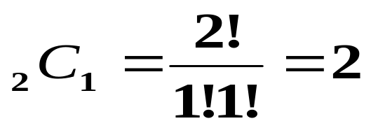
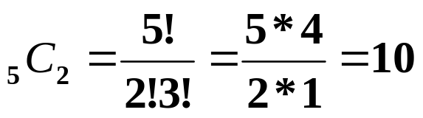
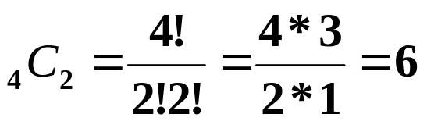
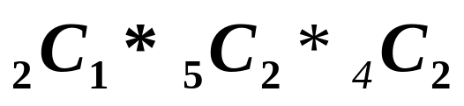
Combinations
Practice:
A basketball team consists of two centers, five forwards, and four guards. In how many ways can the coach select a starting line up of one center, two forwards, and two guards?
Center:
Forwards:
Guards:
Thus, the number of ways to select the starting line up is 2*10*6 = 120.

Slide 52
Question 9
Four people need to be selected from a class of 15 to help clean up the campus. How many different ways can the 4 people be chosen, if the only two girls refuse to help?

Slide 53
Question 10
A basketball team has 12 members who can play any position. How many different ways can the coach choose 5 starting players?

Slide 54
Question 11
A basketball team has 12 members who can play any position. How many different ways can the coach choose 5 starting players if the captain MUST play the first half?

Slide 55
Question 12
When ordering a pizza, you can choose 2 toppings from the following: mushrooms, olives, pepperoni, pineapple, and sausage. How many different types of pizza can you order?

Slide 56
Question 13
Nine people in a writing contest are competing for first, second and third prize. How many ways can the 3 people be chosen?

Slide 57
Question 14
You are ordering a triple-scoop ice-cream cone. There are 18 flavours to choose from and you don’t care which flavor is on the top, middle, or bottom. How many different ways can you select a triple-scoop ice-cream cone?

Slide 58
Question 15
An art gallery has 12 paintings in storage. They have room to display 4 of them, with each painting in a different room. How many possible ways can they display the 4 paintings?

Slide 59
And swap again…...

Slide 60
Question 9
Four people need to be selected from a class of 15 to help clean up the campus. How many different ways can the 4 people be chosen, if the only two girls refuse to help?
The order of outcomes is not important, so this situation involves combinations.
13 Choose 4 = 715

Slide 61
Question 10
A basketball team has 12 members who can play any position. How many different ways can the coach choose 5 starting players?
The order of outcomes is not important, so this situation involves combinations.
¹²C₅ = 792

Slide 62
Question 11
A basketball team has 12 members who can play any position. How many different ways can the coach choose 5 starting players if the captain MUST play the first half?
The order of outcomes is not important, so this situation involves combinations.
¹¹C₄ = 330

Slide 63
Question 12
When ordering a pizza, you can choose 2 toppings from the following: mushrooms, olives, pepperoni, pineapple, and sausage. How many different types of pizza can you order?
The order of outcomes is not important, so this situation involves combinations.
Combinations: 5 choose 2 = 10

Slide 64
Question 13
Nine people in a writing contest are competing for first, second and third prize. How many ways can the 3 people be chosen?
The order of outcomes is important, so this situation involves permutations.
Permutation: 9 x 8 x 7 = 504

Slide 65
Question 14
You are ordering a triple-scoop ice-cream cone. There are 18 flavours to choose from and you don’t care which flavor is on the top, middle, or bottom. How many different ways can you select a triple-scoop ice-cream cone?
The order of outcomes is not important, so this situation involves combinations.
18 choose 3 = 816

Slide 66
Question 15
An art gallery has 12 paintings in storage. They have room to display 4 of them, with each painting in a different room. How many possible ways can they display the 4 additional paintings.
The order of outcomes is important, so this situation involves permutations.
12 arrange 4 = 11,880

Slide 67
Recap
A combination is a grouping of outcomes in which the order does not matter.
A permutation is an arrangement of outcomes in which the order does matter.

Slide 68

Bit strings
How many bit strings of length 10 contain:
exactly four 1’s?
  Find the positions of the four 1’s
  Does the order of these positions matter?
    Nope!
    Positions 2, 3, 5, 7 is the same as positions 7, 5, 3, 2
  Thus, the answer is C(10,4) = 210
at most four 1’s?
  There can be 0, 1, 2, 3, or 4 occurrences of 1
  Thus, the answer is:
    C(10,0) + C(10,1) + C(10,2) + C(10,3) + C(10,4)
    = 1+10+45+120+210
    = 386

Slide 69
Bit strings
How many bit strings of length 10 contain:
at least four 1’s?
  There can be 4, 5, 6, 7, 8, 9, or 10 occurrences of 1
  Thus, the answer is:
    C(10,4) + C(10,5) + C(10,6) + C(10,7) + C(10,8) + C(10,9) + C(10,10)
    = 210+252+210+120+45+10+1
    = 848
  Alternative answer: subtract from 2¹⁰ the number of strings with 0, 1, 2, or 3 occurrences of 1
an equal number of 1’s and 0’s?
  Thus, there must be five 0’s and five 1’s
  Find the positions of the five 1’s
  Thus, the answer is C(10,5) = 252

Slide 70
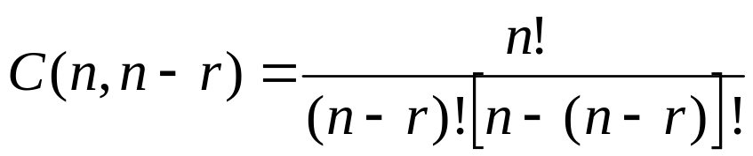
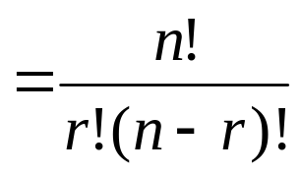
Corollary 1
Let n and r be non-negative integers with
r ≤ n. Then C(n,r) = C(n,n-r)
Proof:

Slide 71
Corollary example
There are C(52,5) ways to pick a 5-card poker hand
There are C(52,47) ways to pick a 47-card hand
P(52,5) = 2,598,960 = P(52,47)
When dealing 47 cards, you are picking 5 cards to not deal
  As opposed to picking 5 card to deal
  Again, the order the cards are dealt in does matter

Slide 72
Combinatorial proof
A combinatorial proof is a proof that uses counting arguments to prove a theorem
  Rather than some other method such as algebraic techniques
Essentially, show that both sides of the proof manage to count the same objects
Most of the questions in this section are phrased as, “find out how many possibilities there are if …”
  Instead, we could phrase each question as a theorem:
  “Prove there are x possibilities if …”
  The same answer could be modified to be a combinatorial proof to the theorem

Slide 73
Circular seatings
How many ways are there to sit 6 people around a circular table, where seatings are considered to be the same if they can be obtained from each other by rotating the table?
First, place the first person in the north-most chair
  Only one possibility
Then place the other 5 people
  There are P(5,5) = 5! = 120 ways to do that
By the product rule, we get 1*120 =120
Alternative means to answer this:
There are P(6,6)=720 ways to seat the 6 people around the table
For each seating, there are 6 “rotations” of the seating
Thus, the final answer is 720/6 = 120

Slide 74
Horse races
How many ways are there for 4 horses to finish if ties are allowed?
  Note that order does matter!
Solution by cases
  No ties
    The number of permutations is P(4,4) = 4! = 24
  Two horses tie
    There are C(4,2) = 6 ways to choose the two horses that tie
    There are P(3,3) = 6 ways for the “groups” to finish
      A “group” is either a single horse or the two tying horses
    By the product rule, there are 6*6 = 36 possibilities for this case
  Two groups of two horses tie
    There are C(4,2) = 6 ways to choose the two winning horses
    The other two horses tie for second place
  Three horses tie with each other
    There are C(4,3) = 4 ways to choose the two horses that tie
    There are P(2,2) = 2 ways for the “groups” to finish
    By the product rule, there are 4*2 = 8 possibilities for this case
  All four horses tie
    There is only one combination for this
  By the sum rule, the total is 24+36+6+8+1 = 75

Slide 75
Thank You

